Slide 1


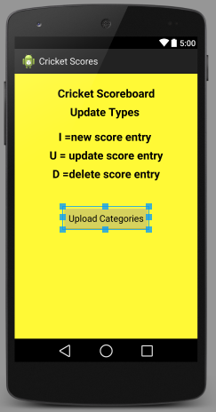

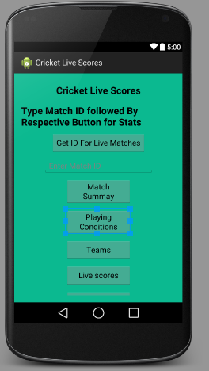

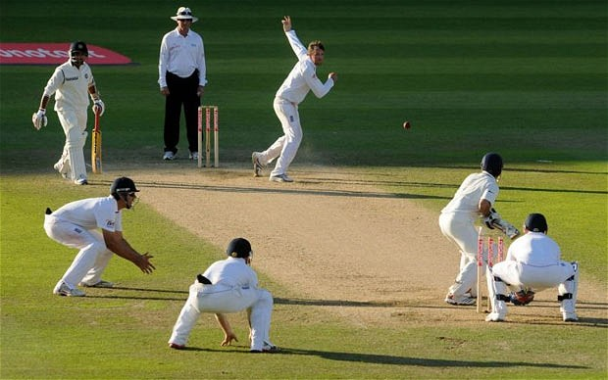
Cricket Score
Keeping
App
User App
Admin App
Cricket Match

Slide 2


Cricket Score
Keeping App
Database
Server
User App
Admin
Score
Keeper
Mobile App

Slide 3
Description of project
Database – MySQL Database.
Webserver-Apache Server.
Server side Scripting Language PHP.
Project Consists of Two Android Applications.
One App is called Admin Score Keeping App.
Other App is called User App.

Slide 4
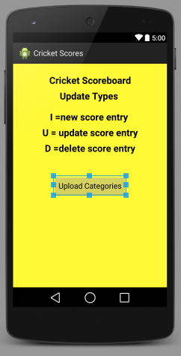
Admin Score Keeper App Main Activity
Main Activity Defines about Update Types and Starts new Activity for different categories of uploads with the Button press.

Slide 5
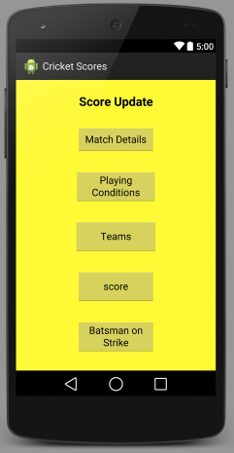
Register Activity
Register Activity have 5 Options
Each Buttons Starts New Activity

Slide 6
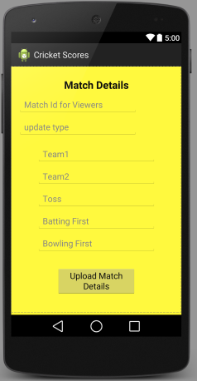
Match Details
This Activity has
7 Text Fields
1st Text Field for Id number for viewers
2nd is for update Type
3rd and 4th for Team Names
5th for the Team who won the Toss
6th for Batting Team
7th for Bowling Team

Slide 7
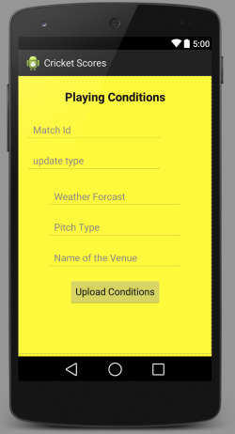
Playing Conditions
This Activity has Text
Fields for Match ID, Update Type , Weather
Forecast , Pitch Type
And for the Name of the Venue

Slide 8
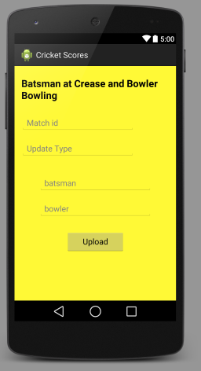
Current Batsman And Bowler
This Activity has
Text Fields for Match ID, update Type, Batsman Batting and Bowler Bowling.

Slide 9
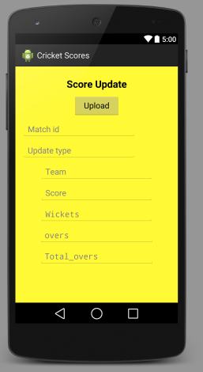
Score Update
This Activity has
Text Fields for Match Id , update Type , Team Name, Score , Wickets , Overs , Total Overs

Slide 10
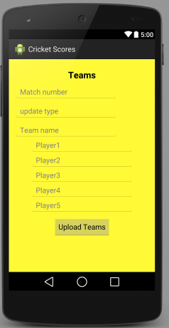
Teams
This Activity has
Text fields for Team Name and Players Playing from that Team.

Slide 11
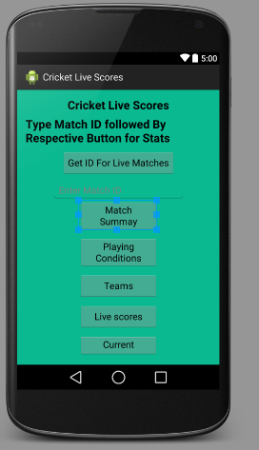
User App
In User App Main Activity has 6
Buttons and a text field.
Get ID is used to get Ids for all on going matches.
Text Field is used to type Match ID followed by Respective Buttons for Particular Stats.

